Slide 1
Project Management Introduction (H17D 34)
HNC Computing

Slide 2
Course Outline
Project Definition √
Project Management Triangle √
Work Breakdown Structure (WBS) √
Project Life Cycle √
Project Management Methodologies
Project Stakeholders √
Project Roles & Responsibilities √
Brainstorming & Team Work
Project Planning, Scoping & Monitoring
Project Costing & Budgeting
Critical Path Analysis √
Project Management Tools – MS Project, Gantt chart…
Class Exercises – Project Management Tasks

Slide 3
Part D: Critical Path Analysis (CPA)
Notes:
Q. Which of the WBS stage will you consider as the most important and least important during project management, and why? Explain your answers

Slide 4
Critical Path Analysis
The critical path through a project is the longest route between dependencies or the minimum time required to complete the project
Critical Path Analysis (CPA), is sometimes called ‘Network Analysis’
It is a tool used to plan activities so that a job/task can be completed in the shortest time possible.
It breaks a job down into a number of tasks, and looks at the dependency of them (i.e. how one task depends or relate to the other)
For example, list the activities that must be completed in order to make a cup of coffee…
Note: CPA is commonly used in manufacturing and construction projects. ( Also applicable in other projects as well)
Notes:
Q. Which of the WBS stage will you consider as the most important and least important during project management, and why? Explain your answers

Slide 5
Critical Path Analysis – Contd…
If any task on the critical path is delayed, then the project will finish late
Analysing the critical path allows critical tasks to be prioritised when planning, and can help with the identification of slippages or slack in the plan when tracking tasks
The reliability of the critical path depends on accurate estimates of time and of resources required.
Critical path analysis can be complex, especially if it has to be done manually
It depends on knowing which task has to finish before another starts, and which tasks can run in parallel
Note: In the example on next slide, the project can have a draft advertisement ready by the end of day three, but the advert can't be published until the personnel department confirms the job grade in the middle of week two.
Notes:
Q. Which of the WBS stage will you consider as the most important and least important during project management, and why? Explain your answers

Slide 6
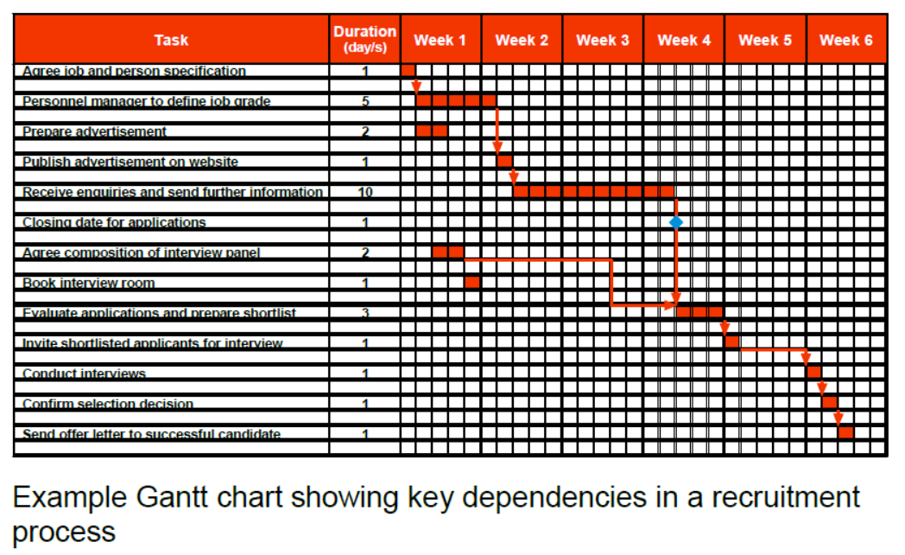
Critical Path Analysis – Contd…
Notes:
Q. Which of the WBS stage will you consider as the most important and least important during project management, and why? Explain your answers

Slide 7
Critical Path Analysis – Contd…
The critical path uses two key dates:
The earliest start date (this depends on the duration of preceding activities)
The latest finish date (the date on which the task must be completed if it is not to delay later tasks)
Note:
If these two dates are known, the amount of float available (i.e. free time) can be identified.
For example, a task is estimated to take two days. It can't start until day seven and it must be finished by day 11.
This allows four days between the earliest start date and the latest finish date. Subtract the task duration (two days) from this and a float equal to two days is left. Where the float is zero, there must be a critical event on the critical path.
Notes:
Q. Which of the WBS stage will you consider as the most important and least important during project management, and why? Explain your answers

Slide 8

CPA – Network (Introduction)
A CPA Network consists of two things:
An Activity
This requires time and/or resources
They can be drawn as arrows from left to right
The length of the arrow is Not important
A Node
This represent the start and the end of an activity
They can be represented by circles
Every network MUST start and end with a node
Notes:
Q. Which of the WBS stage will you consider as the most important and least important during project management, and why? Explain your answers

Slide 9
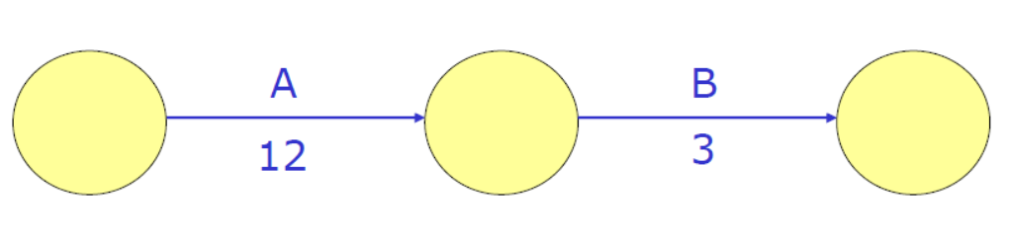
CPA – Network Diagram (Running Simple Activities)
The simple example below is used to show how to setup CPA Network Diagram:
Example: A business plans to build a new factory
Before this can be done, the following needs to be done first
Activity A - Buy the land (Time – 12 weeks)
Activity B – Draw up Plans (Time – 3 weeks)
The length of the arrow is Not important
A simple network diagram to illustrate the above scenario can be sown below
Notes:
Q. Which of the WBS stage will you consider as the most important and least important during project management, and why? Explain your answers

Slide 10
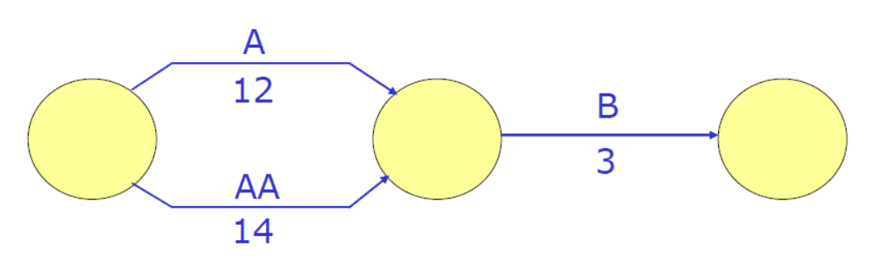
CPA – Network Diagram (Running Simultaneous Activities)
In real life scenarios, there are several times where more than one activities are carried out, that is performing activities simultaneously.
Example: Referring to previous example…
Assume that whilst in the process of buying the land the company wants to apply for planning permission
Activity AA – Apply for Planning Permission (Time – 14 weeks)
A network diagram illustrating the simultaneous activities (buy land & apply for planning permission) is shown below
Notes:
Q. Which of the WBS stage will you consider as the most important and least important during project management, and why? Explain your answers

Slide 11
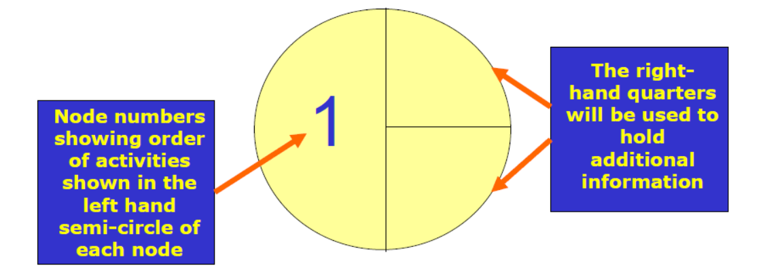
Developing The CPA – Network Diagram
It is important to include key details of the activities in the nodes we have created.
This helps to be able to identify each nodes in the CPA network diagram and also to be able to identify the crucial activities.
Once the crucial activities are identified, then the ‘Critical Paths’ can also be determined.
The nodes should be designed to include/represent the following information in the network diagram.
Notes:
Q. Which of the WBS stage will you consider as the most important and least important during project management, and why? Explain your answers

Slide 12
Calculating Critical Paths’ Time
A. The Earliest Start Time (EST)
This refers to the earliest possible time at which any given task or activity can start.
It is called the Earliest Start Time (EST) of the task or activity.
The EST of a given task or activity can be calculated using the formula;
Notes:
Q. Which of the WBS stage will you consider as the most important and least important during project management, and why? Explain your answers

Slide 13
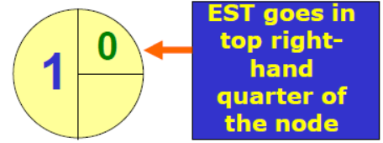
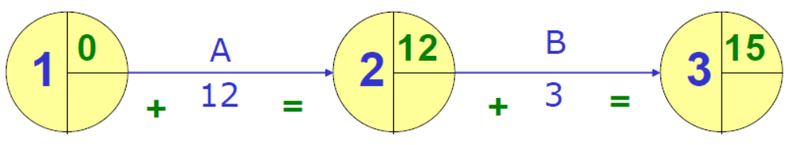
Calculating Critical Paths’ Time
A. The Earliest Start Time (EST) – Simple Activity
This information is then placed in the top right-hand quarter of the node.
Note:
The first node will always have an EST of zero.
Referring to previous example, we can calculate the EST for each activity as follows:
Notes:
Q. Which of the WBS stage will you consider as the most important and least important during project management, and why? Explain your answers

Slide 14
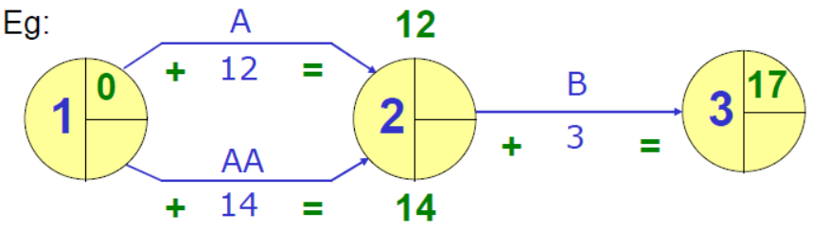
Calculating Critical Paths’ Time
A. The Earliest Start Time (EST) – Simultaneous Activities
When there are simultaneous activities, there may be more than one value for the EST.
From Previous Example: with simultaneous activities, we can find the EST as follows
Note – from the network diagram above:
Since Activity B is DEPENDENT on both Activities A & AA, it cannot start until both activities are completed.
The HIGHEST value (i.e. in this case 14 weeks for activity AA) is usually selected as the EST
Thus, the EST from the network diagram above is 14 weeks.
Notes:
Q. Which of the WBS stage will you consider as the most important and least important during project management, and why? Explain your answers

Slide 15
Earliest Start Time (EST) – Summary
The EST of the first activity or task is always zero.
The EST is usually calculated by working from left – right on the CPA network diagram.
The EST is calculated using the following formula:
Whenever two activities are to be carried out at same time (i.e. simultaneously), the HIGHEST figure/value of time required to complete any of the task is taken as the EST.
Notes:
Q. Which of the WBS stage will you consider as the most important and least important during project management, and why? Explain your answers

Slide 16
Earliest Start Time (EST) – Tutorial 3
Task.
You work for one of the high street coffee shops and you have been asked to make coffee for three customers
Customer 1 – prefers coffee with milk and sugar
Customer 2 – prefers coffee with milk, no sugar
Customer 3 – prefers coffee with no milk, no sugar
Answer the following questions:
Draw a CPA network diagram to represent tasks given above. You should produce 3 network diagrams for each customer.
Determine the Earliest State Time (EST) for each of the network diagrams you have produced.
Notes:
Q. Which of the WBS stage will you consider as the most important and least important during project management, and why? Explain your answers

Slide 17
Calculating Critical Paths’ Time
B. The Latest Finishing Time (LFT)
This refers to the latest possible time at which any given task must end.
This is called the Latest Finishing Time (LFT) of the task or activity.
This helps also help to identify the CRITICAL activities or tasks within the CPA network diagram for specific projects.
The is calculated by working BACKWARDS from right – left across the network diagram using the formula;
Notes:
Q. Which of the WBS stage will you consider as the most important and least important during project management, and why? Explain your answers

Slide 18
Calculating Critical Paths’ Time
B. The Latest Finishing Time (LFT)
This refers to the latest possible time at which any given task must end.
This is called the Latest Finishing Time (LFT) of the task or activity.
This helps also help to identify the CRITICAL activities or tasks within the CPA network diagram for specific projects.
The is calculated by working BACKWARDS from right – left across the network diagram using the formula;
Notes:
Q. Which of the WBS stage will you consider as the most important and least important during project management, and why? Explain your answers

Slide 19
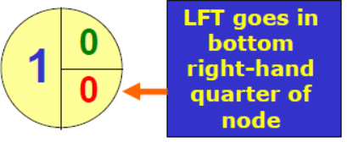
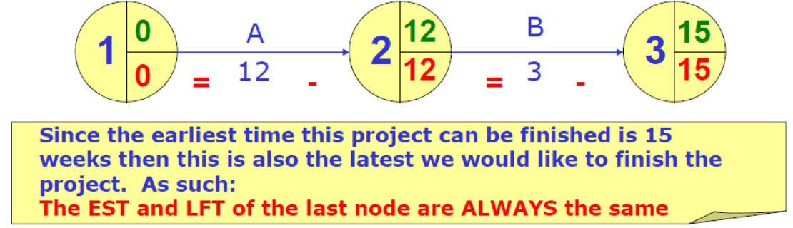
Calculating Critical Paths’ Time
B. The Latest Finishing Time (LFT) – Simple Activity
This information is then placed in the bottom right -hand quarter of the node.
Note:
The first node will always have an LFT of zero.
Referring to previous example, we can calculate the EST for each activity as follows:
Notes:
Q. Which of the WBS stage will you consider as the most important and least important during project management, and why? Explain your answers

Slide 20
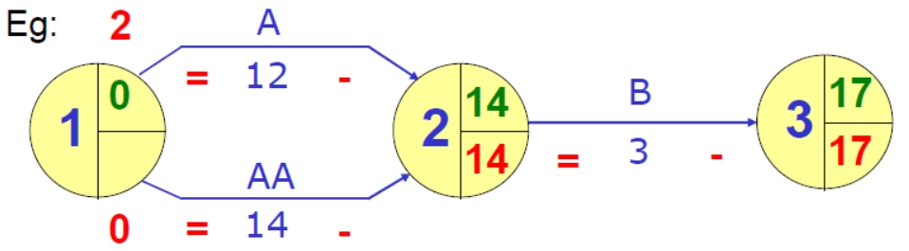
Calculating Critical Paths’ Time
B. The Latest Finishing Time (LFT) – Simultaneous Activities
When there are simultaneous activities, there may be more than one value for the LFT.
From Previous Example: with simultaneous activities, we can find the LFT as follows
Note – from the network diagram above:
If Activity AA starts on week 2, it cannot be completed by week 14.
So we must take the LOWEST figure or value as the LFT.
Thus, the LFT from the network diagram above is week 0.
Notes:
Q. Which of the WBS stage will you consider as the most important and least important during project management, and why? Explain your answers

Slide 21
Latest Finishing Time (LFT) – Summary
The LFT of the last activity is always equal to its EST.
The LFT of the first activity is always zero (0).
The LFT on a CPA network diagram is calculated by working from right - left across the network.
The LFT is calculated using the formula :
Whenever two activities are to be carried out at same time (i.e. simultaneously), the LOWEST figure is used as the LFT.
Notes:
Q. Which of the WBS stage will you consider as the most important and least important during project management, and why? Explain your answers

Slide 22
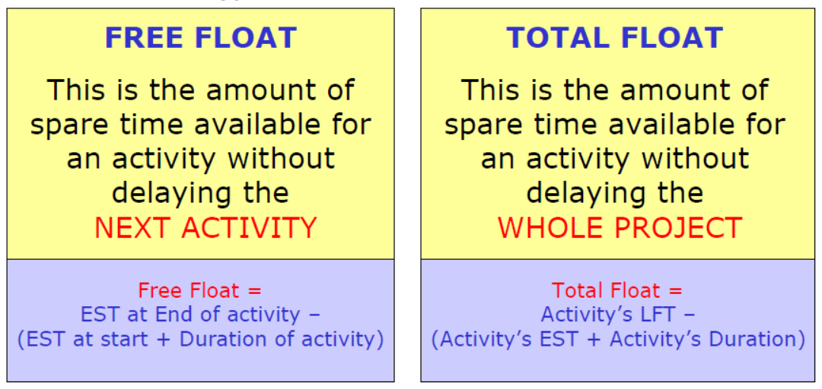
Calculating Critical Paths’ Time
C. The Float
Refers to the spare time available during project management (i.e. from planning – execution)
An activity without any spare time is usually considered – CRITICAL.
Note:
There are two types of float – (i) Free Float and (ii) Total Float
Notes:
Q. Which of the WBS stage will you consider as the most important and least important during project management, and why? Explain your answers

Slide 23
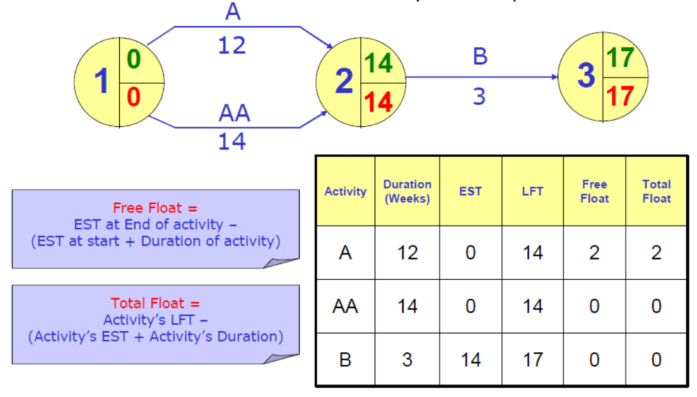
Calculating Critical Paths’ Time
C. The Float – How to Calculate
From Previous Example: the Free & Total Float can be calculated as follows
Notes:
Q. Which of the WBS stage will you consider as the most important and least important during project management, and why? Explain your answers

Slide 24
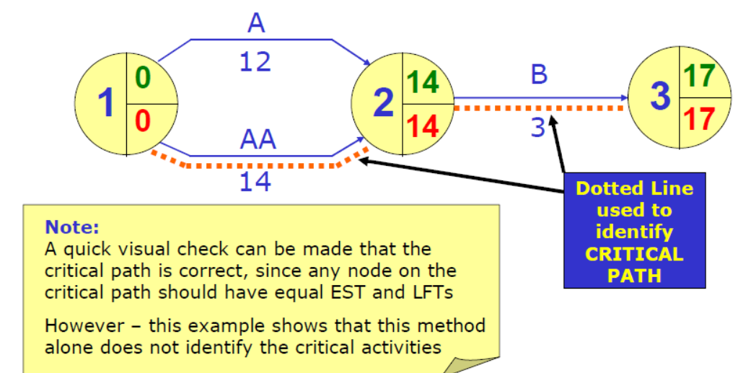
Identifying The Critical Path
The Critical Path identifies activities that has no spare time (i.e. no float)
From Previous Example…
The Critical Path can be identified from previous network diagram as follows:
Notes:
Q. Which of the WBS stage will you consider as the most important and least important during project management, and why? Explain your answers

Slide 25
Advantages of Using CPA in Project Management
It requires careful planning
This helps to run projects smoothly
It improves project running efficiency and cash flow
This helps to run projects smoothly
If problems occur, the implication can be identified quickly
This helps in making informed and timely decisions on the project.
Helps to identify critical path during planning & execution of projects
This helps to prioritise and manage project time and resources efficiently.
Notes:
Q. Which of the WBS stage will you consider as the most important and least important during project management, and why? Explain your answers

Slide 26
Limitation of Using CPA in Project Management
Diagrams can become complex and unmanageable
Although different software is available to help produce CPA networks and manage complexity more easily.
Plan will only work if relevant staff have been consulted
That is, timescales need to be realistic
Gant charts tend to be preferred since they visually show the time-span of activities.
Notes:
Q. Which of the WBS stage will you consider as the most important and least important during project management, and why? Explain your answers

Slide 27
CPA – Tutorial 4
Task.
Create and complete a CPA network diagram to represent a project with the list of following activities:
Activities A (4 days) and B (5 days) can start simultaneously
Activity C (4 days) can begin once activities A and B are complete
Activity D (3 days) can begin once activity B is complete
Activity E (1 day) ends the project and can begin once activities C and D are complete.

